Slide 1

Embedded & Portable Computing Systems (ECE433/ECC533)
Intro to STM32, C Coding & IDE

Slide 2
Example Code
Navigate through the tools
Create a project
Write some code, compile, debug, … etc

Slide 3
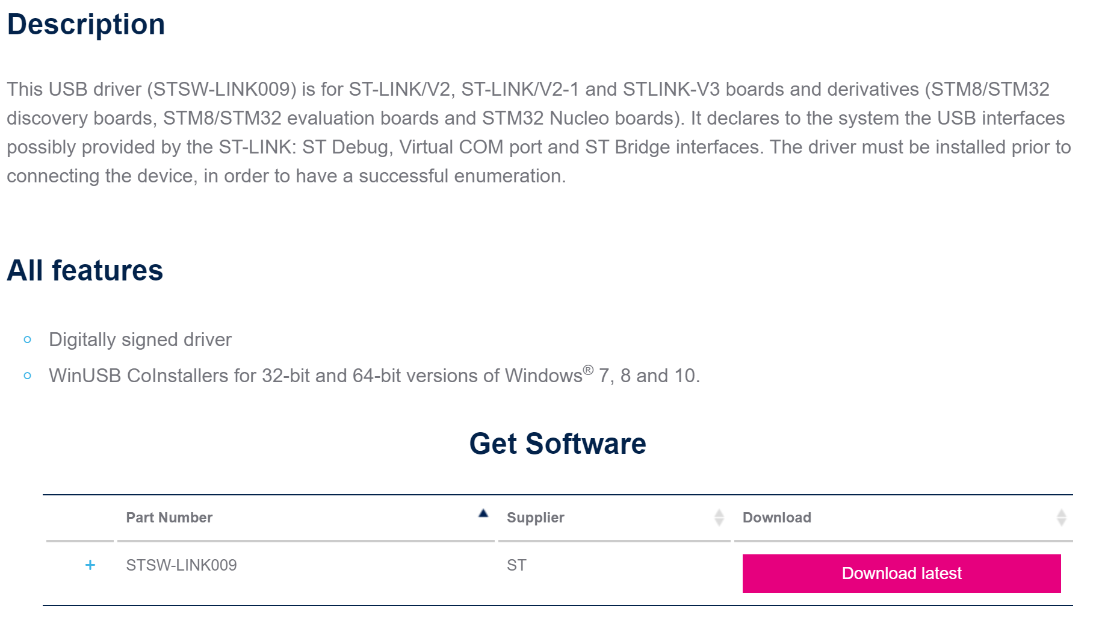
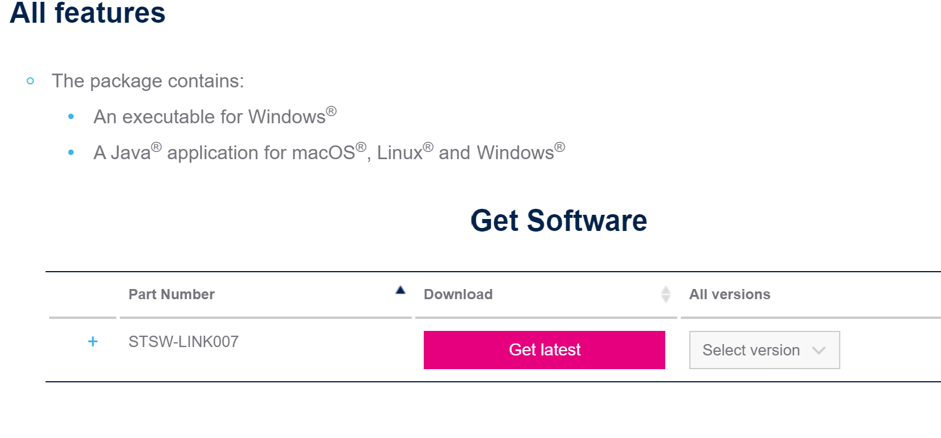
Tool issue
Issues connecting to the board?
Install driver (STSW-LINK009)
Issues communicating with the board?
Install (STSW-LINK007) and upgrade firmware

